Slide 1
Git

Slide 2
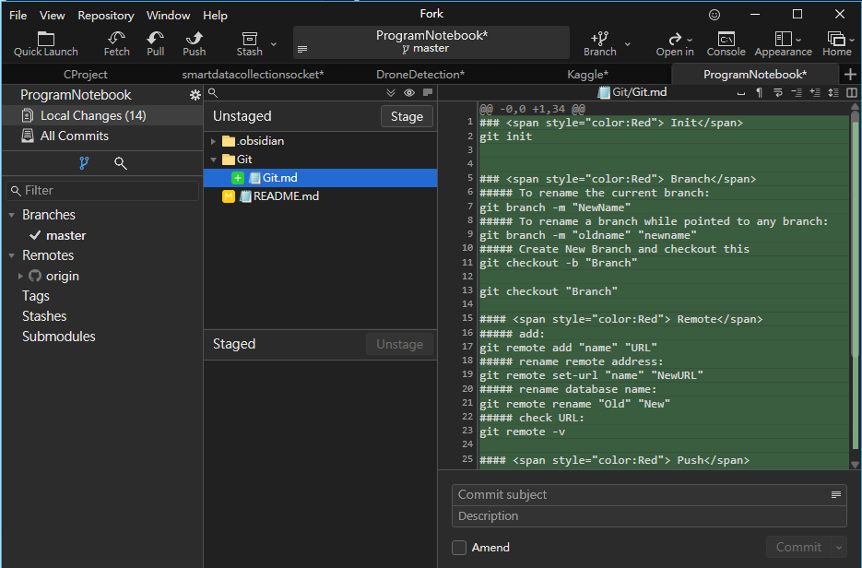
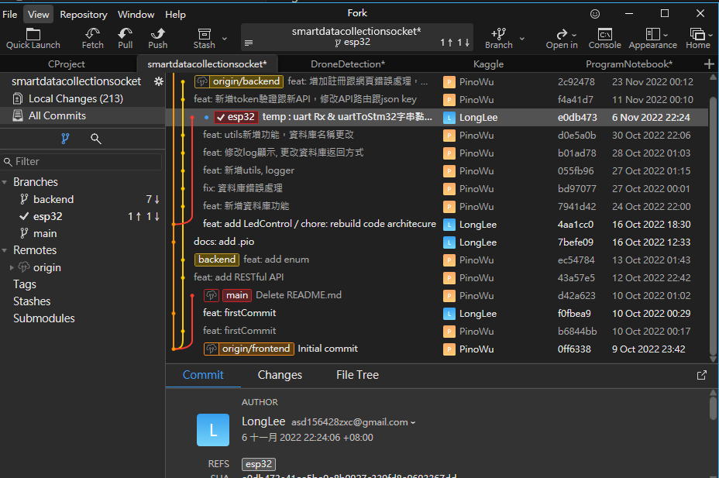
Fork
工作目錄
Tree
暫存區

Slide 3
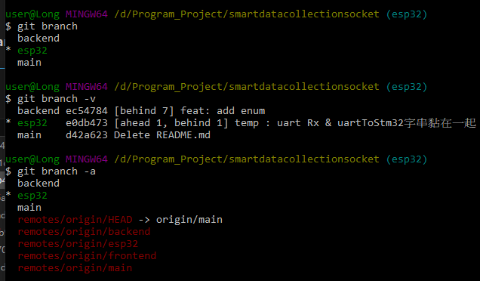
Branch
To rename the current branch:
git branch -m "NewName"
To rename a branch while pointed to any branch:
git branch -m "oldname" " NewName”
Create New Branch and checkout this
git checkout -b "Branch“
Checkout Branch
git checkout "Branch“
Del branch
git branch –d “branch”
https://ithelp.ithome.com.tw/articles/10281080

Slide 4
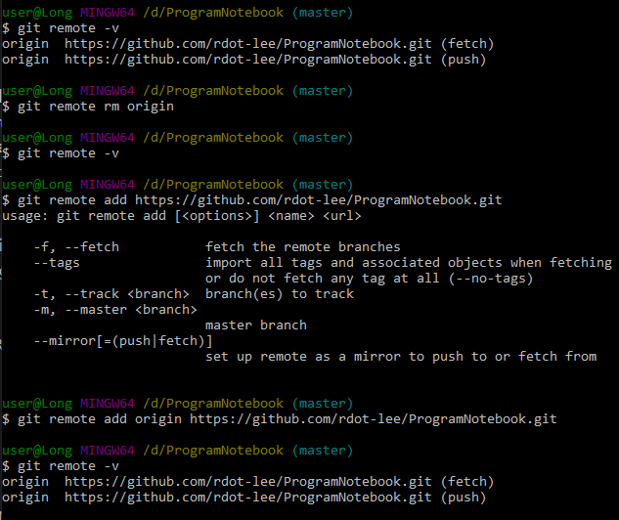
Remote
add:
git remote add "name" "URL“
rename remote address:
git remote set-url "name" "NewURL“
rename database name:
git remote rename "Old" "New“
check URL:
git remote –v
Delete remove origin:
git remote rm(remove) "origin"

Slide 5
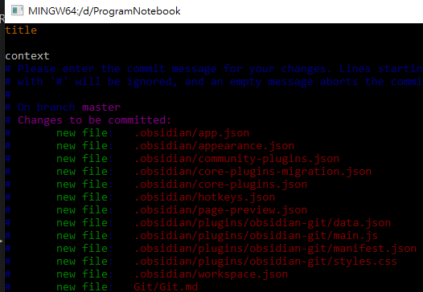
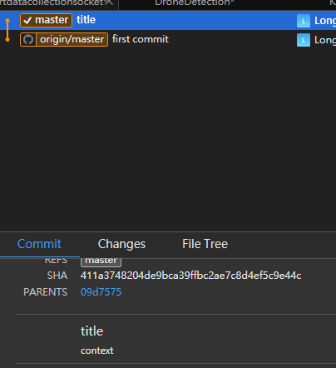
commit
Add message:
git commit -m "message"
git commit ->enter i -> vim UI -> :wq (save)
https://wadehuanglearning.blogspot.com/2019/05/commit-commit-commit-why-what-commit.html

Slide 6
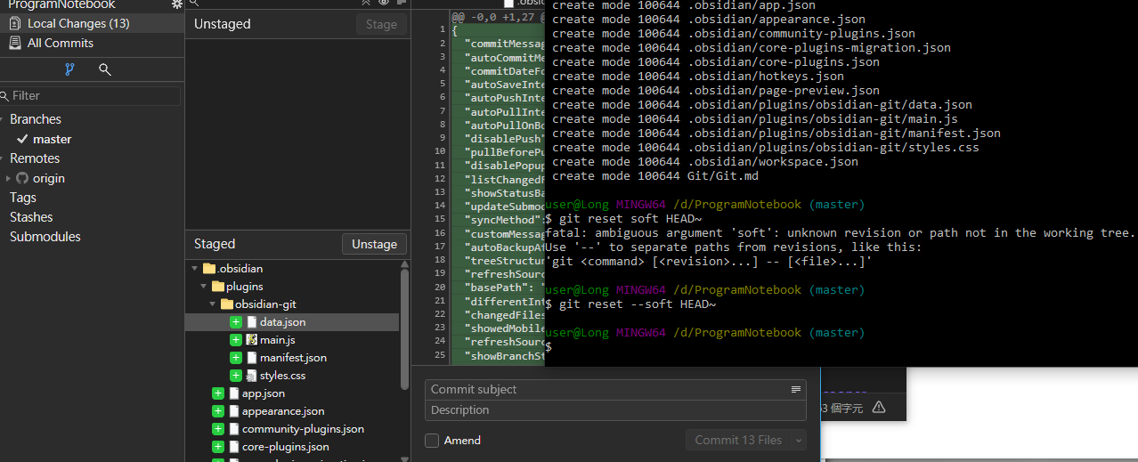
reset
Mixed(defulit) : 回到工作目錄
git reset HEAD~ (HEAD^)
soft : 回到暫存區
git reset --soft HEAD~
hard : 回到最初
git reset –hard HEAD~

Slide 7
Push
常用:
git push –u “remote name” “branch name”

Slide 8
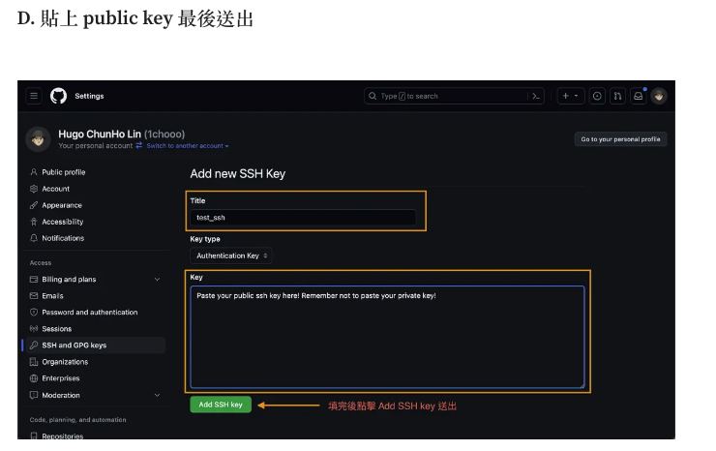
SSH
ssh-keygen -t rsa -b 4096 -C your_email@example.com
ssh-keygen -t ed25519 -C "your_email@example.com "
cat ~/.ssh/id_ed25519.pub
https://medium.com/@1chooo/%E8%B8%8F%E5%85%A5-git-%E7%9A%84%E4%B8%96%E7%95%8C-%E4%BD%BF%E7%94%A8-ssh-%E8%88%87-github-%E9%80%A3%E7%B7%9A-7324b01349dd

Slide 9

config
git config --list
git config --global user.name "John Doe"
git config --global user.email johndoe@example.com

Slide 10
.gitignore(將排除檔案寫入)
Touch .gitignore
Vim .gitignore

Slide 11
merge
Tip：
切換到要合併那條分支，merge被合併分支
Ex :將 one 合併到 Main
step1. 切換到 Main這個分支
$ git checkout main
step2. 合併 one
$ git merge one
Notes:
https://miahsuwork.medium.com/%E7%AC%AC%E4%BA%8C%E9%80%B1-git-%E9%80%B2%E9%9A%8E%E4%BD%BF%E7%94%A8-branch-merge-a571cc0a95de

